Slide 1
Movie and Series Database
Project Java and Web Development Alexander Agricola Matriculation number: 9228068
GitHub: https://github.com/AFKlex/Movie-Series-Watchlist

Slide 2
Purpose of the Web App
The Series/Movies Tracker web application helps users manage and track their viewing experiences by recording details such as name, status, score, dates, current episode, rewatch count, and personal notes. This tool ensures users can easily track progress and plan future viewing schedules.
Destination Group:
Movie and Series Enthusiasts: Manage and remember progress for a large content volume.
Reviewers and Critics: Keep detailed notes and scores for reviews.
Students and Academics: Organize and analyze different works for study.
Casual Viewers: Simple tool to track watched and planned content.
Content Creators and Bloggers: Maintain an organized list for reference.

Slide 3
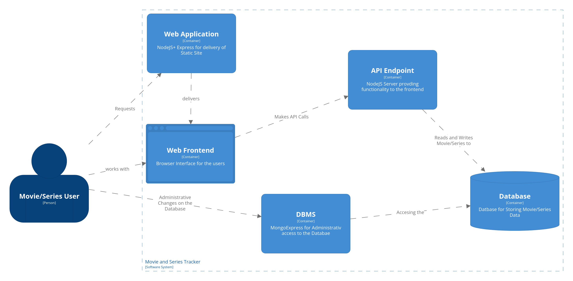
Architecture Diagram

Slide 4
Technology Stack
Frontend | Backend | Deployment + Others
HTML | NodeJS | Docker
CSS | MongoDB | Docker-Compose
JavaScript | Express | MongoExpress (DBMS)
 | CORS
 | Body-Parser
 | Node Mongoclient

Slide 5
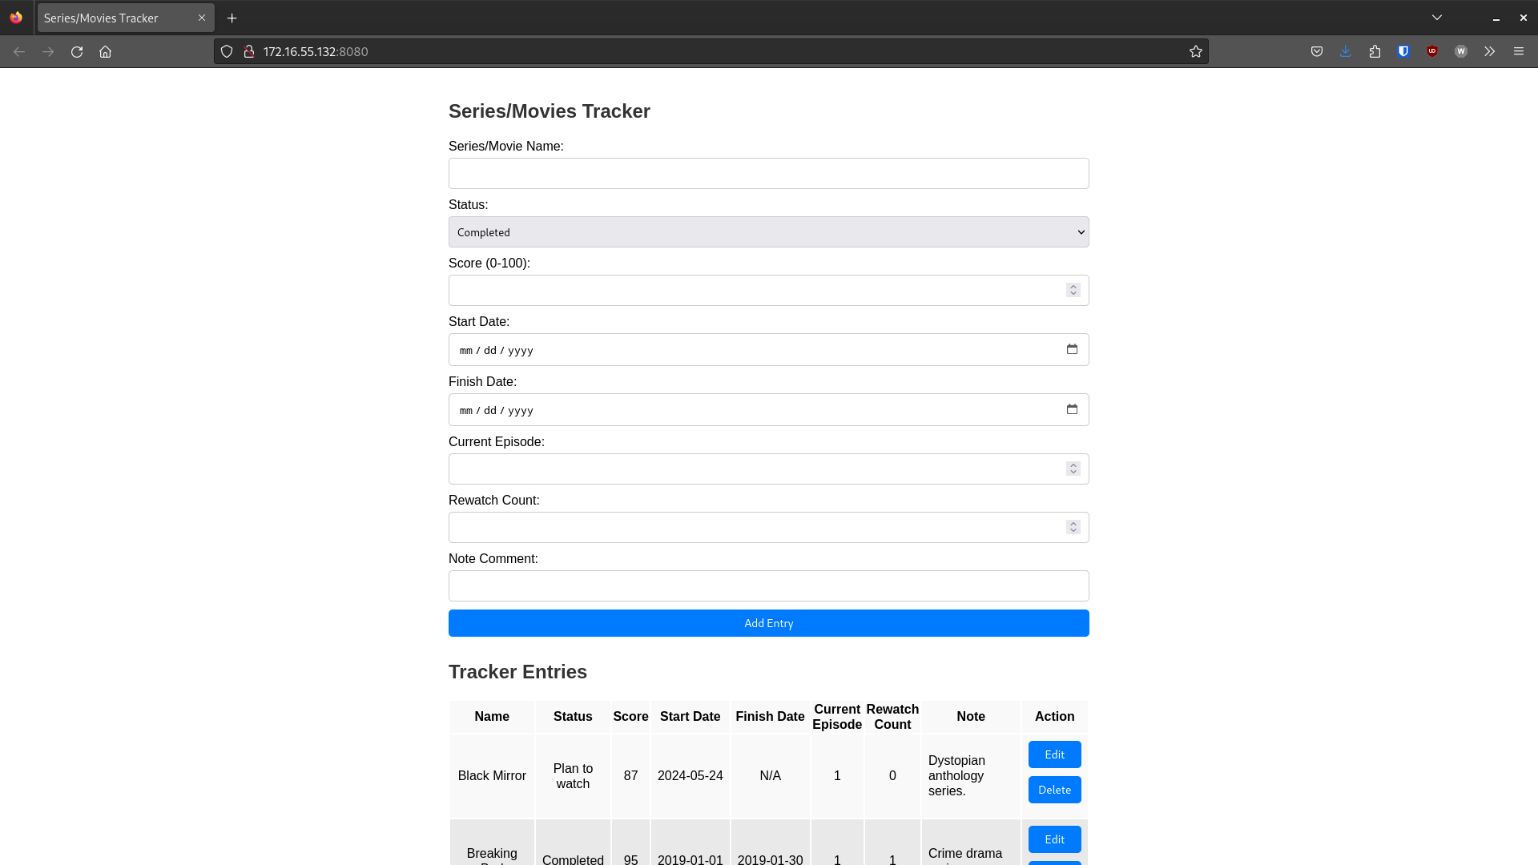
Area for adding and editing data.
Drop down for status selection.
Drop down for status selection.
Drop down for status selection.
Area for adding and editing data.
To sort the items, simply click on the headers.

Slide 6
Changes between: Conception phase - Development phase
I have kept everything mostly the same. For the front end, I kept with Javascript, HTML, and CSS, which is hosted on a NodeJS +Express application to serve the User.
However, I decided to add MongoExpress as a Database Management System for administrative changes on the Database, like exporting Data.

Slide 7
Test Cases - Editing an Entry
Description: Verify that an existing series/movie entry can be edited successfully.
Preconditions: An entry "Breaking Bad" exists in the table.
Steps:
Click the "Edit" button next to the "Breaking Bad" entry.
Change the "Score" input field to "98"
Click the "Add Entry" button.
Expected Result:
The entry "Breaking Bad" is updated with the new score "98" and appears again at the end of the table.
More Testcases can be found in the README File.

Slide 8
